Slide 1
B24 Software workshop
Diamond Light Source Ltd
Harwell, July 13th 2018
Raw data (tilt series) to tomograms with IMOD
Notes:
I’m going to talk to you about the Diamond cryo X ray tomography beamline, the technique itself and its applications

Slide 2
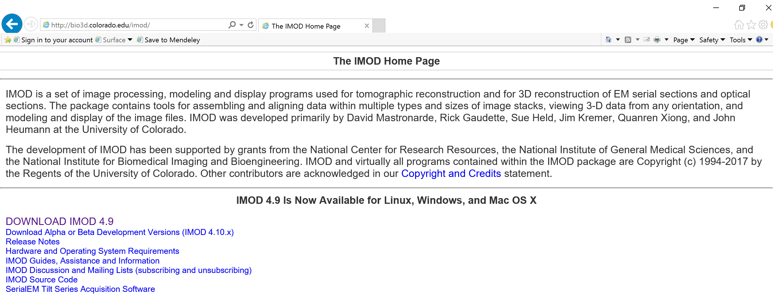
B24 Software workshop
http://bio3d.colorado.edu/imod/doc/tomoguide.html
Navigate into your directory (/dls/tmp/B24_workshopJun2018/user……/Data)
and copy the test_data_1.tiff into your Data folder :
cp /dls/tmp/B24_workshopJun2018/Test_data/test_data_1.tiff test_data1.tiff
Next generating an st file from the tiff stack:
% module load imod/4.9
% tif2mrc test_data1.tiff test_data1.st
Starting Imod
% etomo

Slide 3
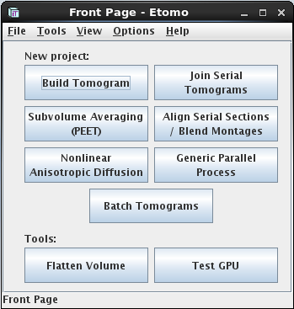
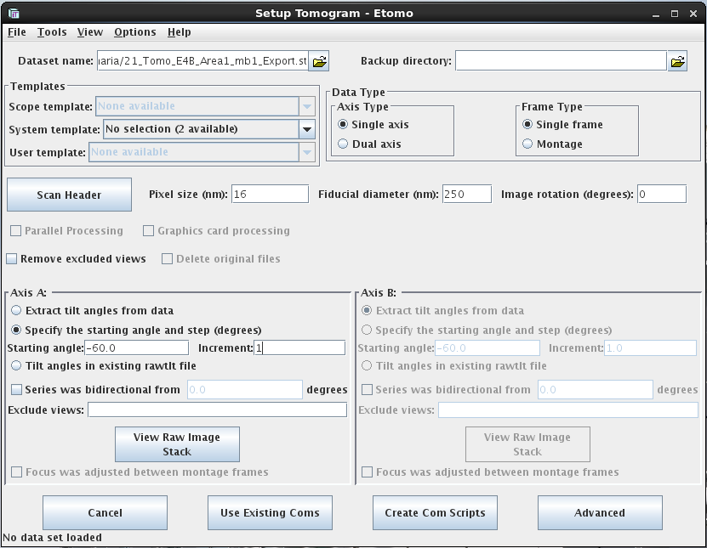
B24 Software workshop
Change pixel size to 10 nm
If your raw tilt series has:
241 slices, increment: 0.5
601 slices, increment: 0.2

Slide 4
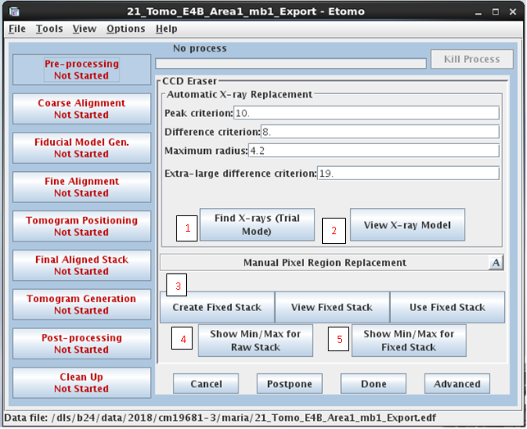
B24 Software workshop
6

Slide 5
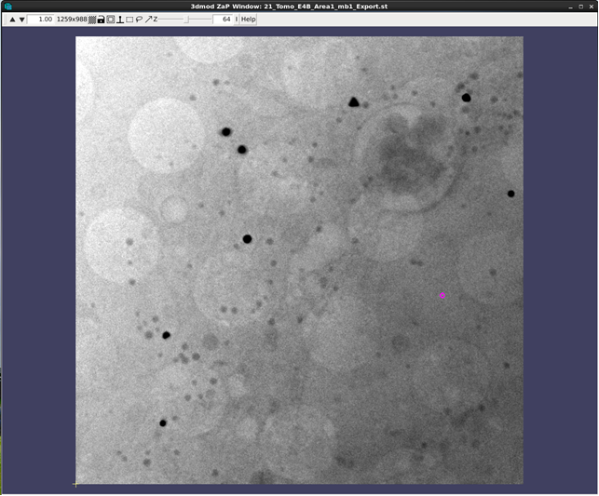
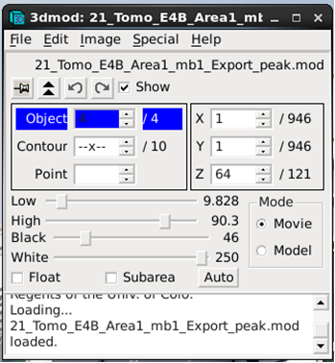
B24 Software workshop

Slide 6
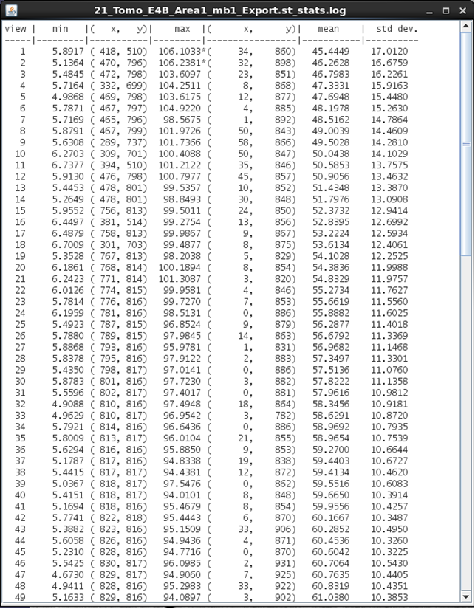
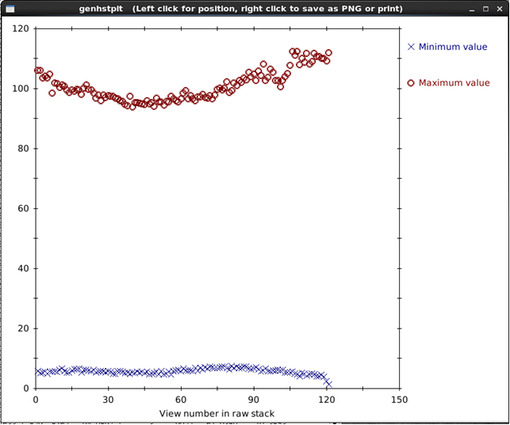
B24 Software workshop

Slide 7
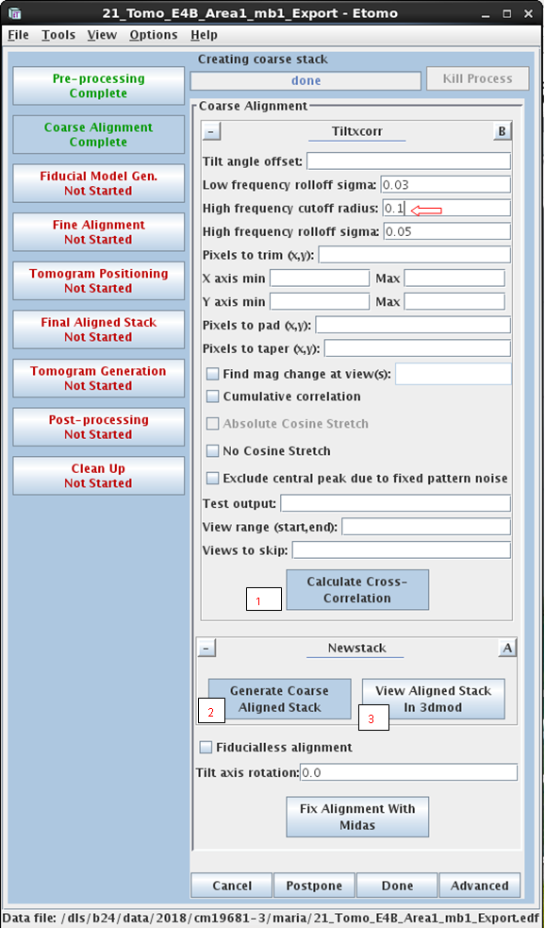
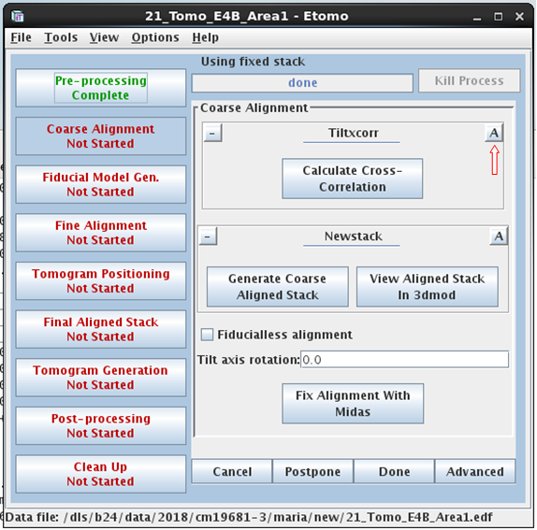
B24 Software workshop

Slide 8
B24 Software workshop
2
1

Slide 9
B24 Software workshop

Slide 10
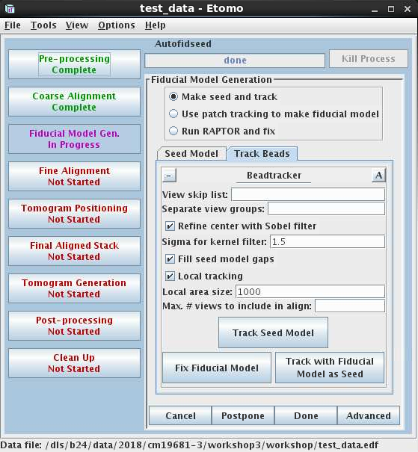
B24 Software workshop

Slide 11
B24 Software workshop

Slide 12
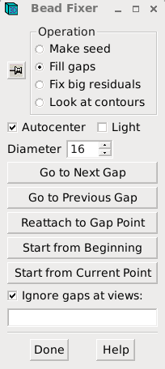
B24 Software workshop
Use the middle mouse button to insert missing points

Slide 13
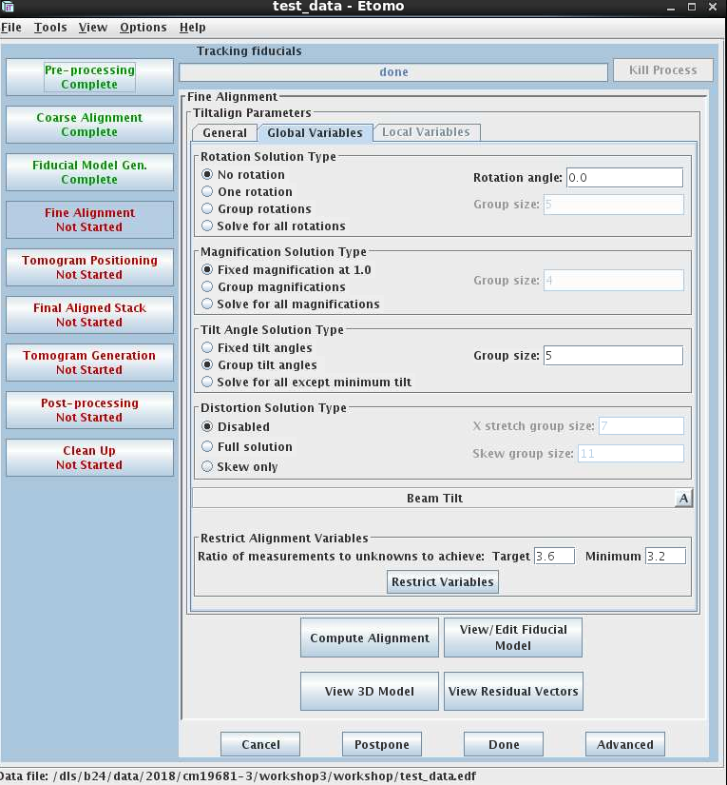
B24 Software workshop
3
4
1
5
2
6
7

Slide 14
B24 Software workshop

Slide 15
B24 Software workshop

Slide 16
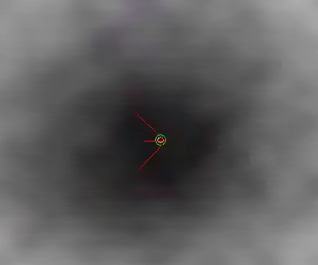
B24 Software workshop
-Move point residual or place by eye (right mouse click).
-Then go to next big residual until no more residuals.
-Next save and run tiltalign and fix new residuals.

Slide 17

B24 Software workshop

Slide 18
B24 Software workshop

Slide 19
B24 Software workshop
1
2

Slide 20
B24 Software workshop
Flip data by going to Edit→image→flip
Reload the data by going to Edit>Image>Reload; then click apply

Slide 21
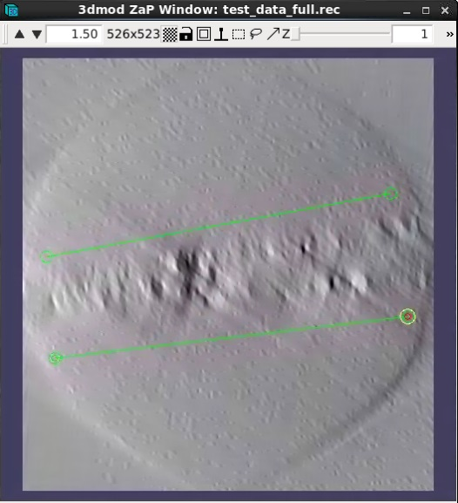
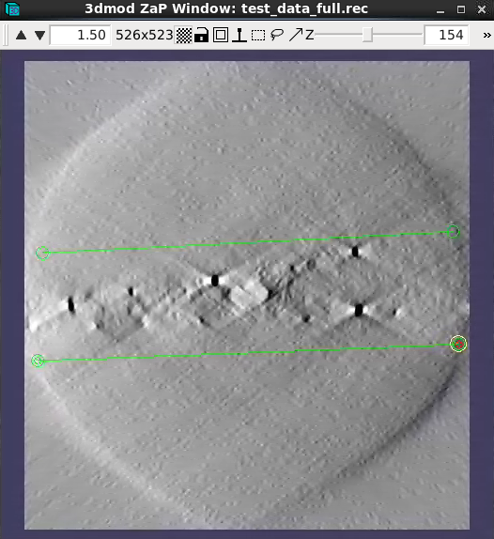
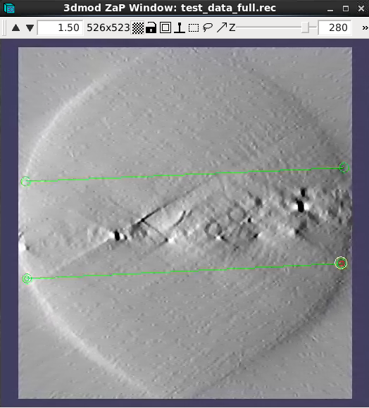
B24 Software workshop
Place 6 contours total, each with 2 points. One at
the beginning of the stack, one in the middle and
one at the end.
Press s to save

Slide 22
B24 Software workshop
3
4

Slide 23
B24 Software workshop
1
2

Slide 24
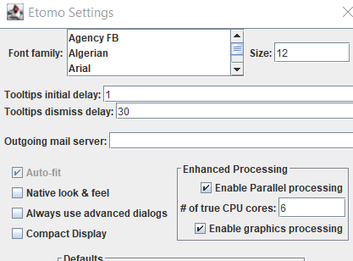
Optional:
For faster reconstruction, enable parallel processing and choose the max number of CPUs your computer has
In IMOD go to options – settings
How to find out the number of CPUs your computer has: Task manager – performance – CPU – cores – add this number here, then restart etomo (only need to do this once)

Slide 25
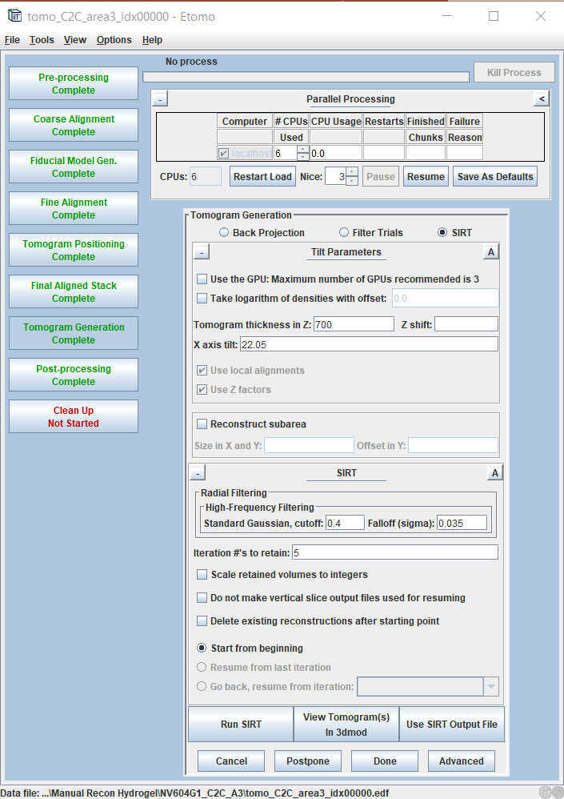
If you want to do iterative reconstruction (SIRT) (recommended)
Choose a low ‘Nice’ value if you don’t need to use your computer for other things while reconstruction happens, the lower the nice value, the more processing power is allocated to etomo

Slide 26
If you want to do weighted back projection – faster but lower quality
B24 Software workshop
Try 5 or 10
1
2

Slide 27
B24 Software workshop

Slide 28
B24 Software workshop
Image XYZ

Slide 29
B24 Software workshop
Place rubber band around dataset

Slide 30
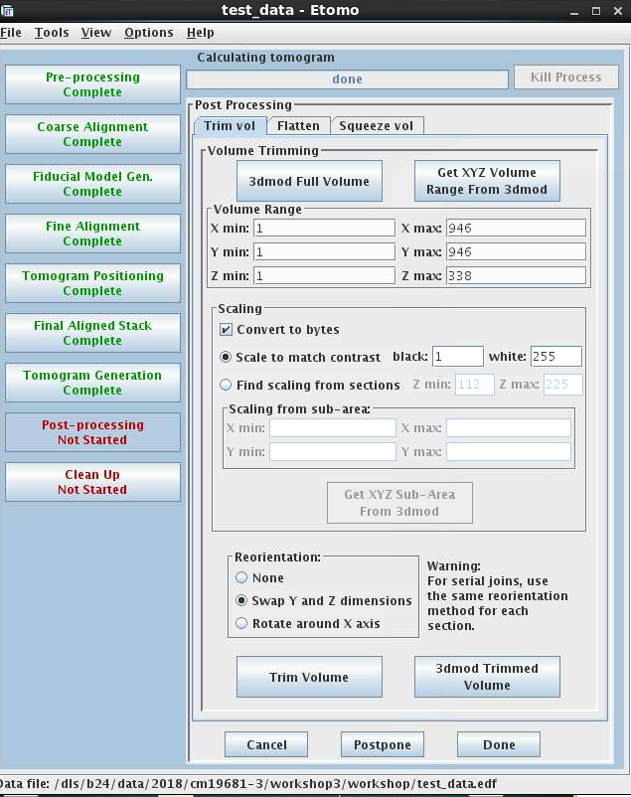
B24 Software workshop
1
1
2
Note: Only do this if you want an 8-bit image. If you don’t want to reduce the bit size of your image then follow the next slide instead (recommended)
H
Have a look at your wonderful reconstruction
3
4

Slide 31
B24 Software workshop
For data set 1 we will use
X min 100 max 700
Y min 100 max 700
Z min 150 max 190
Data set 2
X min 100 max 700
Y min 300 max 900
Z min 160 max 260
1
1
2
Un-tick
H
Have a look at your wonderful reconstruction
This saves the .rec file
3
4

Slide 32
B24 Software workshop

Slide 34
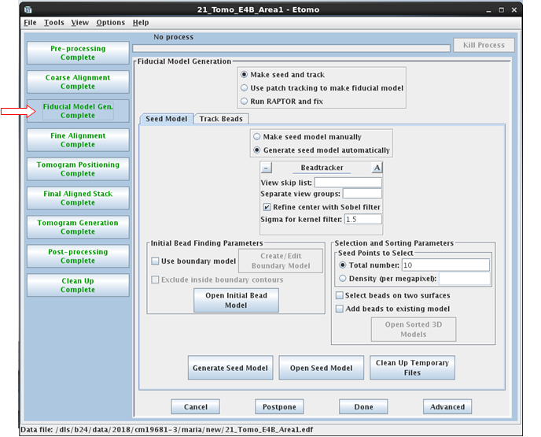
B24 Software workshop:
Special case 1. Adding fiducials to the seed model and getting Imod to track them.

Slide 35
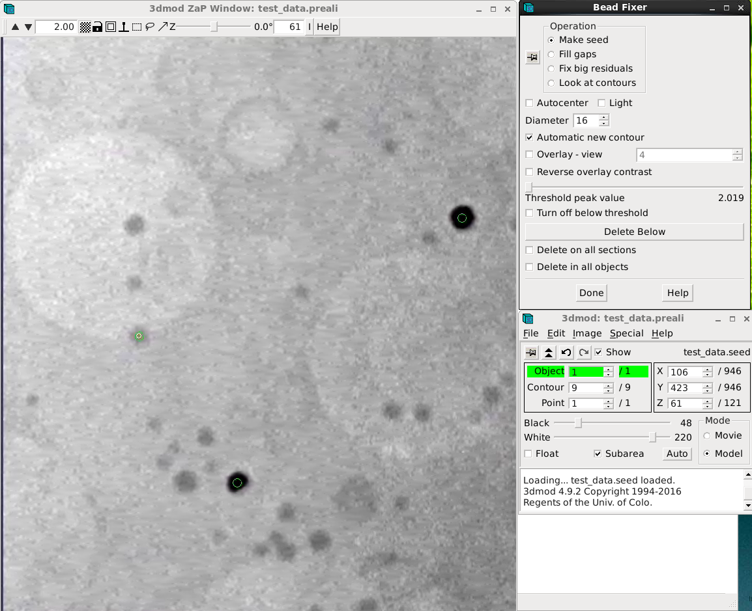
-Press n to make a new contour.
-Untick autocenter
-Middle mouse click the fiducial you want to add
-Press s to save

Slide 36
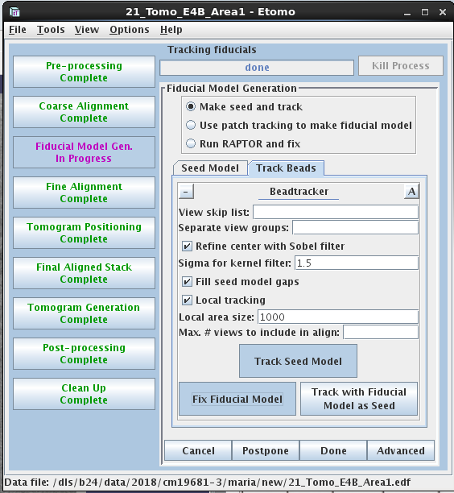
B24 Software workshop
Track the seed model
Fix the fiducial model by filling any gaps and remove or correcting points that do not follow the fiducial.
Press s to save the model and run through the rest of the reconstruction process.
1
2

Slide 38
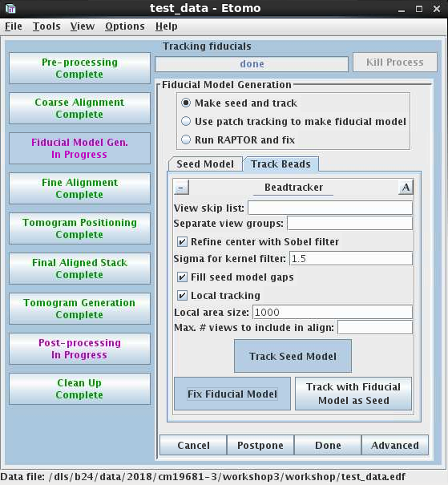
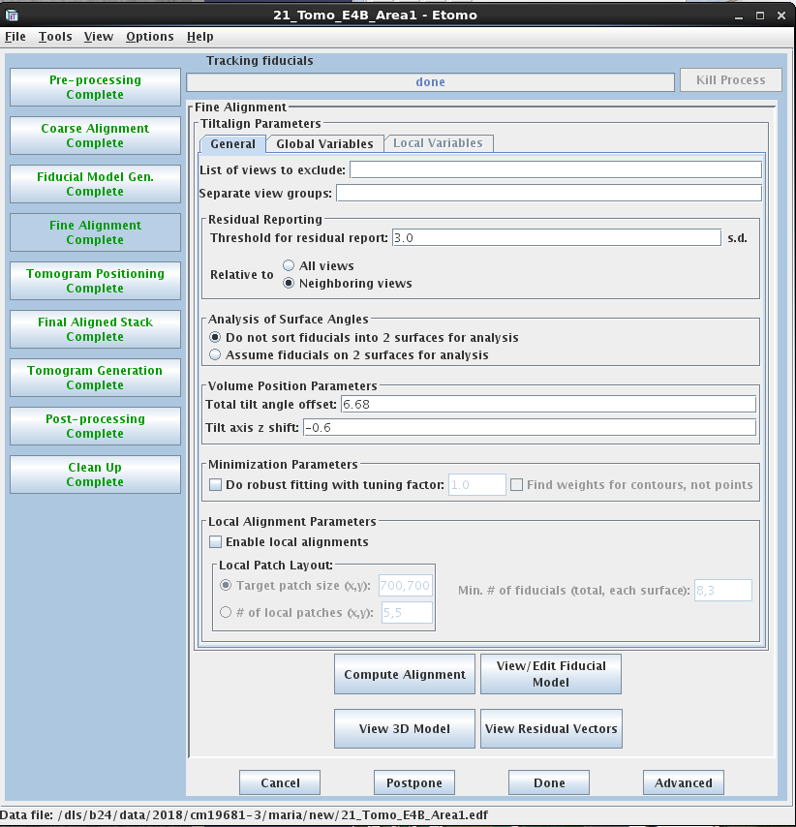
Special case 2. Adding a fiducial fully manually
Can be done in fiducial model generation or the fine alignment tab

Slide 39
-Press n to make a new contour.
-Untick autocenter
-Middle mouse click the fiducial you want to add

Slide 40
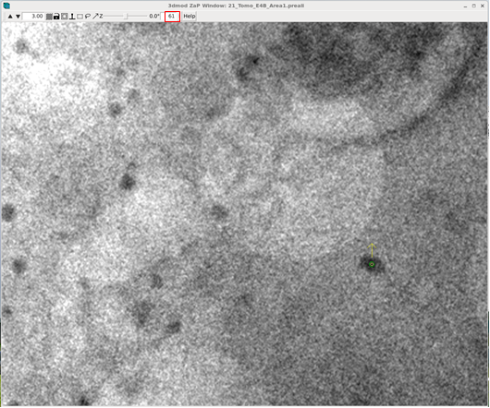
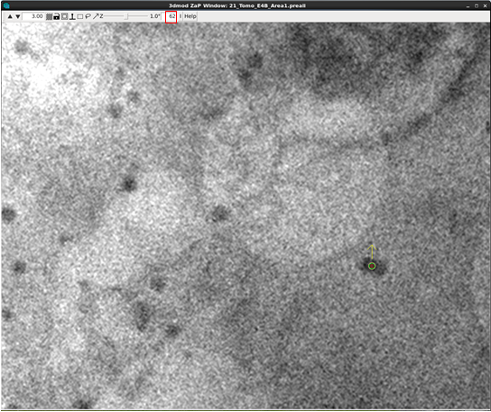
B24 Software workshop
Go to the next angle (page up or down) and add another point to the contour.
Once you have marked the fiducial at as many angles as possible click s to save the model. The run through the rest of the reconstruction process.

